Slide 1

CMPUT 328 - Fall 2019
Assignment 8:
Semantic Segmentation

Slide 2
Semantic Segmentation:
Semantic segmentation is the task of classifying each and very pixel in an image into a class as shown in the image below. Here you can see that all persons are red, the road is purple, the vehicles are blue, street signs are yellow etc.
Ref: https://towardsdatascience.com/semantic-segmentation-popular-architectures-dff0a75f39d0

Slide 3
Deep Learning Model Architectures for Semantic Segmentation:
Fully Convolutional Network (FCN) [J. Long et al. (2015)]
U-Net [O. Ronneberger et al. (2015)]
DeepLab [L.-C. Chen et al. (2017)]
SegNet [V. Badrinarayanan et al. (2015)]
PSPNet [H. Zhao et al. (2016)]

Slide 4

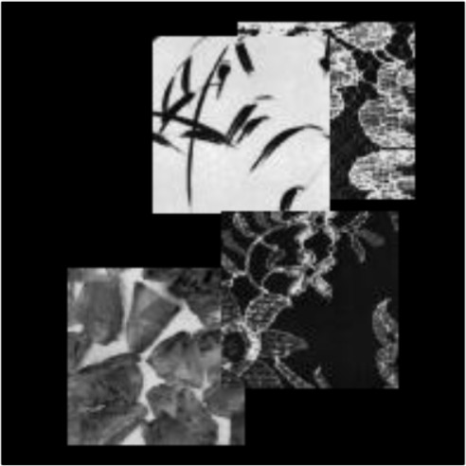
Semantic Segmentation on Texture Images dataset
The Texture Images dataset was created by placing these 4 texture images randomly on blank images of size 196x196:
A sample image by this procedure is shown below:
Notes:
Paramater sharing

Slide 5
Semantic Segmentation on Texture Images dataset
There are 2000 samples in the train set and 500 samples in the test set.
Each sample consists of an RGB image of size (1, 196, 196, 3) and a mask of size (1, 196, 196, 1)
The mask tells us which texture each pixel belongs to.
It will have value from 0 to 4: 0 is the background class (i.e. that pixel belong to no class),
1-4 are for the 4 classes of the 4 texture.
Notes:
Paramater sharing

Slide 6
Task
Your task in this assignment is to do semantic segmentation on this dataset.
There are no architecture requirements or guidelines.
Your mark will scale linearly with the pixel accuracy of your segmentation, starting from 90.5% (0 mark) and cap at 98.5% (75 Marks)
Notes:
Paramater sharing

Slide 7
References
https://towardsdatascience.com/semantic-segmentation-popular-architectures-dff0a75f39d0
https://medium.com/@arthur_ouaknine/review-of-deep-learning-algorithms-for-image-semantic-segmentation-509a600f7b57

